Slide 1
Callbacks, Promises and API Calls
More JS: Callbacks, Promises and Arrow Functions
API calls in the browser

Slide 2
Code examples
https://github.com/claraj/week6-examples

Slide 3
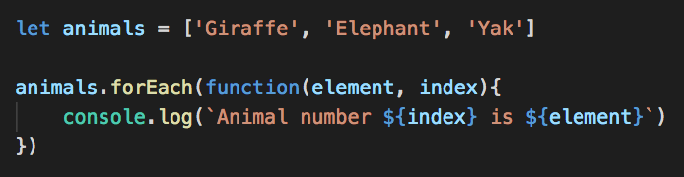
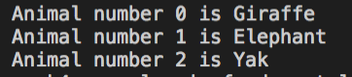
Functions as arguments to other functions
Functions can be passed to other functions as arguments

Slide 4
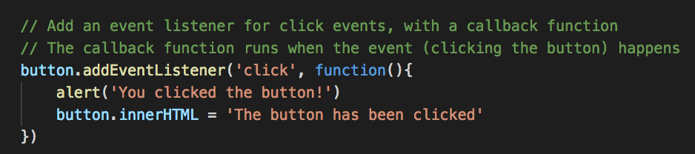
Functions as arguments to other functions
You’ve also used these with event handlers
Function definition as argument to other function – a callback
When the event happens, the callback function will be called
This pattern is very common, to describe what tasks should be performed sometime in the future

Slide 5
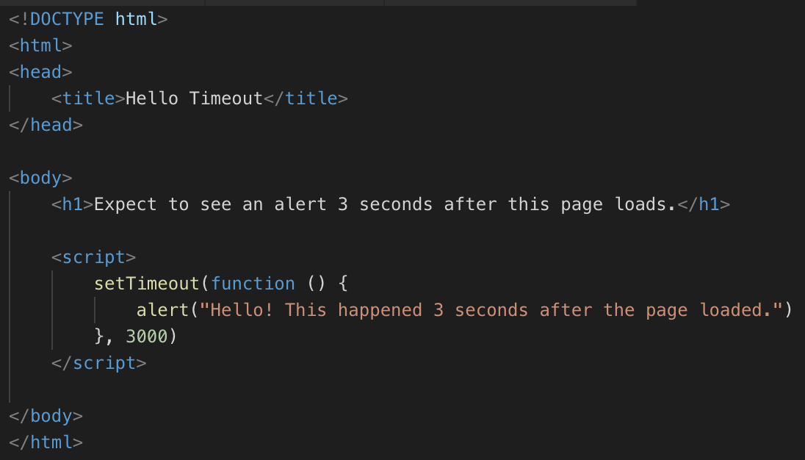
setTimeout call a function after a delay
Another callback function
Write and view this page
Wait 3 seconds - do you see the alert?
3000 is the delay before the function is called
Delay specified in milliseconds, 1000ths of a second

Slide 6
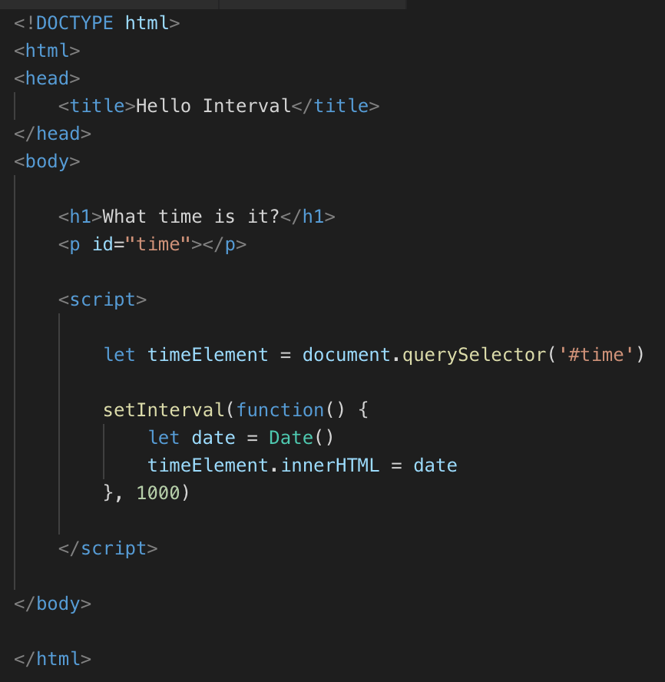
setInterval calls a function repeatedly
Your Turn: What Time Is It? page
Do you see the date and time updating?
1000 is the interval between function calls
Interval specified in milliseconds, 1000ths of a second

Slide 7
JavaScript is single-threaded
It can only do one thing at once
For tasks that might take a long time, you must start the task, and then provide a function to be called when that task is done, and a separate function to be called if the task fails/errors
Otherwise your program just has to wait = frozen page until task is done
Poor user experience
Better if your program can continue to do other tasks; respond to events, while it is waiting

Slide 8
Examples of slow tasks
Fetching data from a database
Fetching data from an API
Processing data returned from a database call or API call
Loading an image from a file
Image processing
Saving a file
Deliberately waiting for a period of time

Slide 9
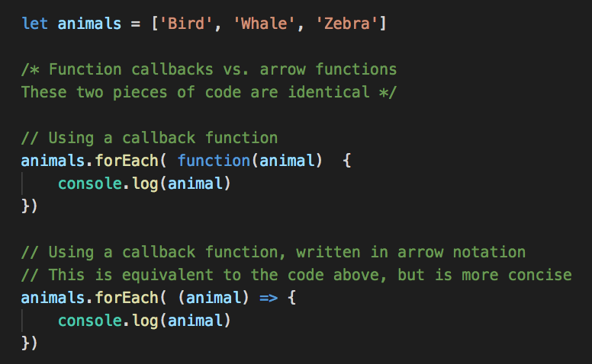
Arrow Functions
Syntax to simplify writing a callback function
Omit the word function
Add an arrow after the parameter

Slide 10
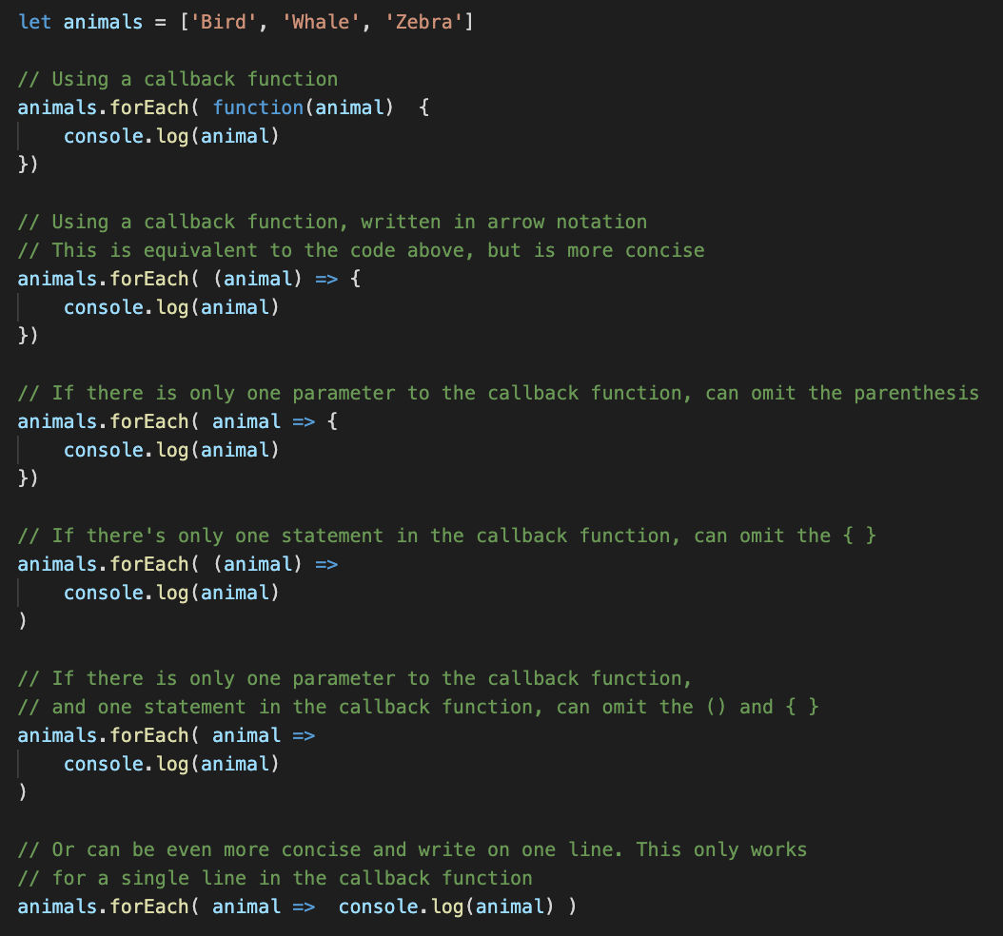
Arrow Functions shortcuts
If there's only one argument to the callback function, can omit the parenthesis around the argument
If there is only one line in the callback function, can omit the curly braces { }
The one-line version is common

Slide 11
Your Turn
Modify your What Time Is It? page so the setInterval function callback uses the arrow function notation
Hint: do you still need parenthesis in a function definition, even if it doesn't have any parameters?

Slide 12
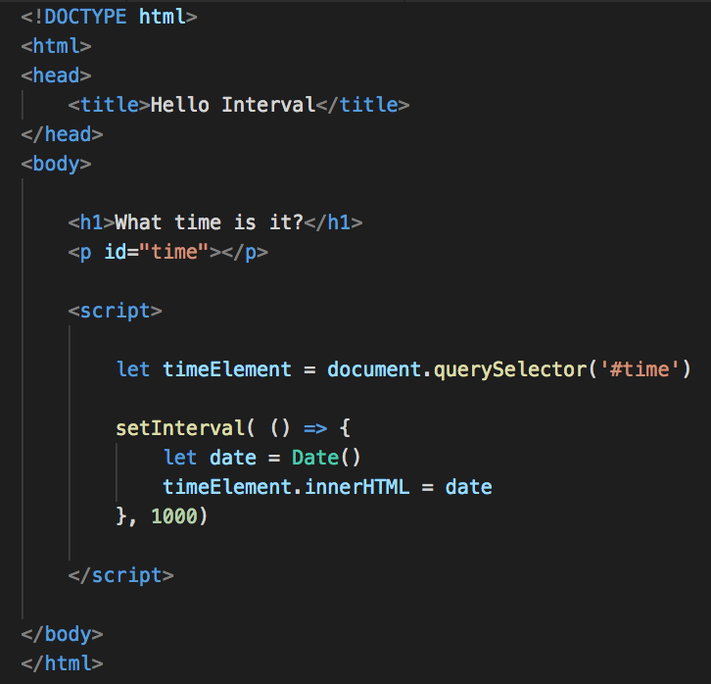
Solution
Remove the word function
Add arrow => between the parameter's parenthesis, and the function body
Must include empty parenthesis if the callback function does not take any arguments

Slide 13
API: Application Programming Interface
Two meanings:
1. a general term for the methods and functions provided by a program or library
"JavaScript’s API includes methods like querySelector() and setInterval()"
2. A service provided by a server that other programs can connect to and make requests over HTTP, and receive responses that can be used in a program
Responses are often in JSON format, but can be various other types of data
Remember your web browser also makes HTTP requests, and a server responds with HTML, CSS, images, JS…

Slide 14
APIs
Many APIs – for example, the World Bank has an API that provides data about countries
Income level, GDP, financial information, climate….
Try this URL in your browser
https://api.worldbank.org/v2/country/br?format=json
Change br – the country code for Brazil - to the country code of your choice – for example, try ch for Switzerland or in for India or zw for Zimbabwe or us for the USA
https://en.wikipedia.org/wiki/List_of_ISO_3166_country_codes

Slide 15
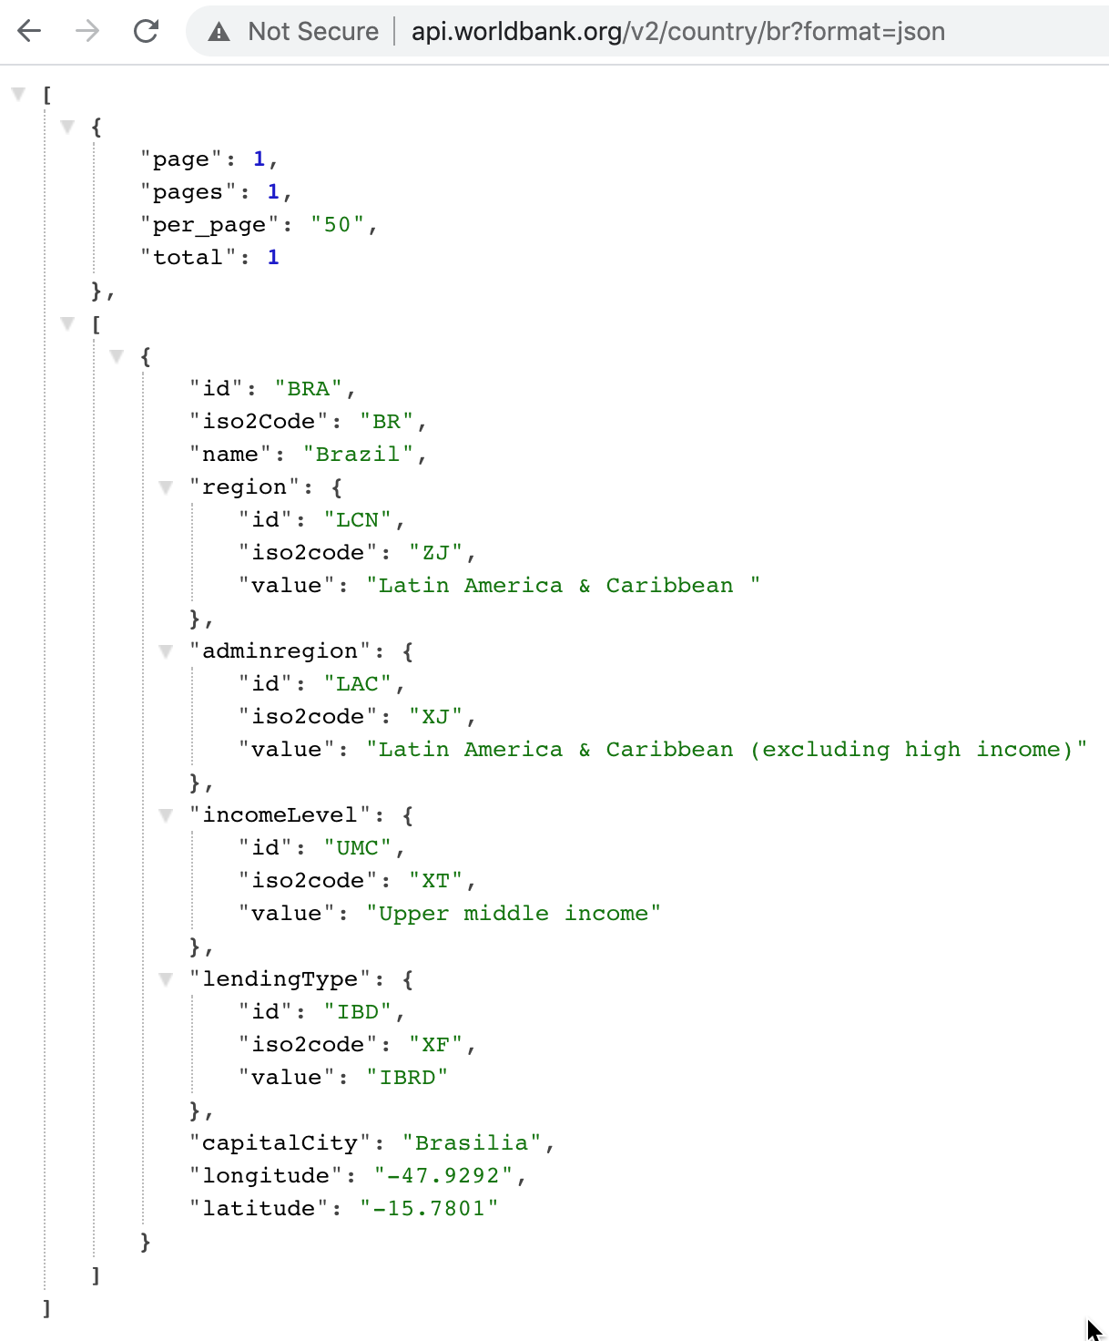
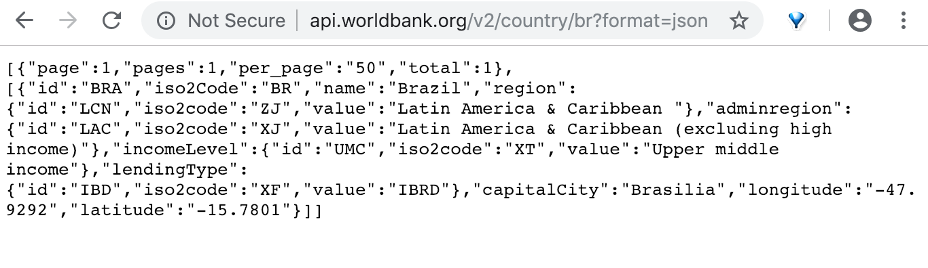
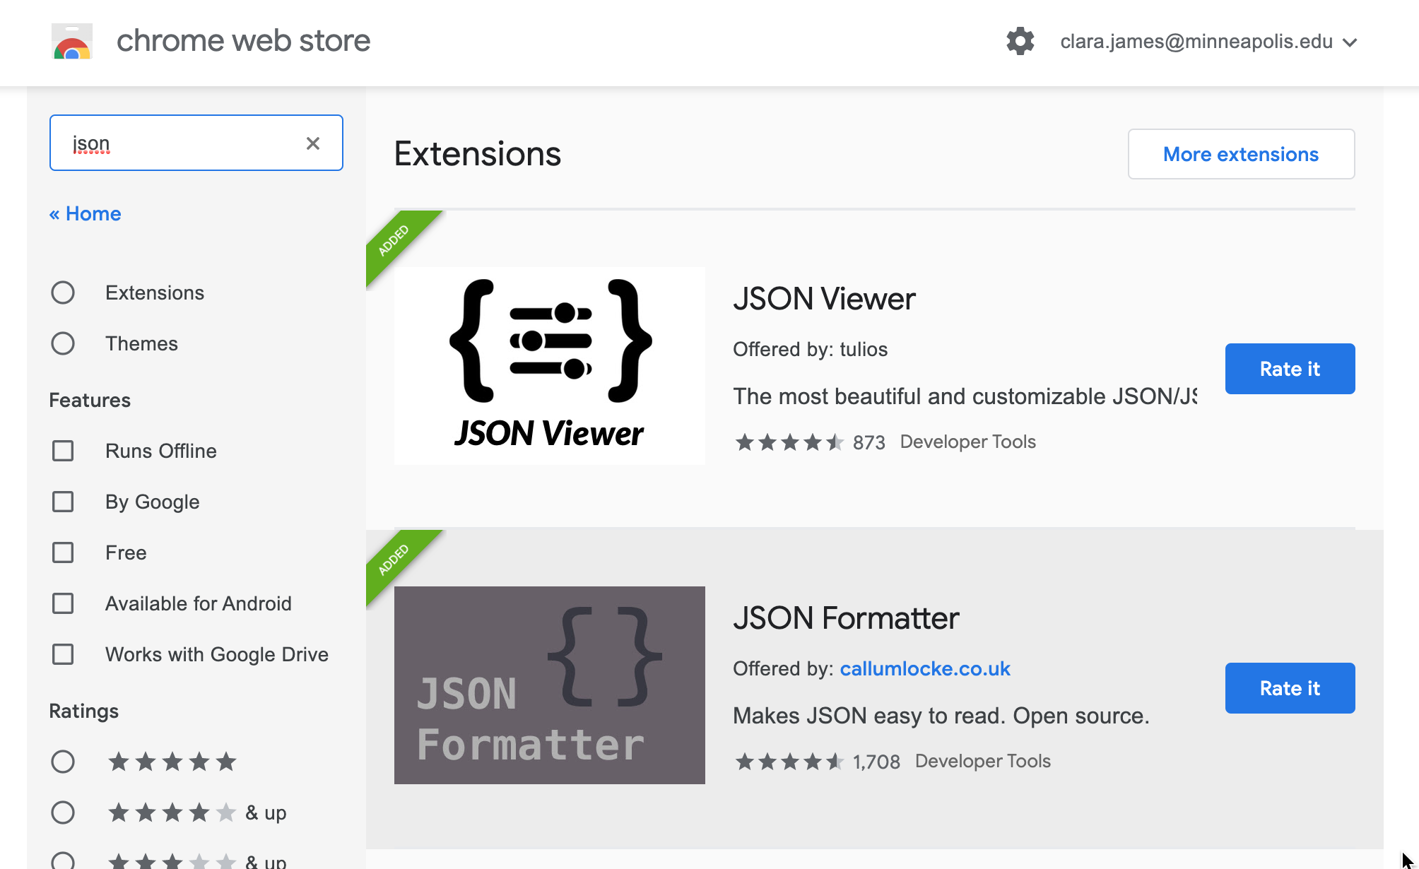
JSON response
Notice the response is a JSON string
Firefox will display JSON neatly
Chrome users: install a browser extension like JSON Formatter
https://chrome.google.com/webstore/category/extensions?hl=en

Slide 16
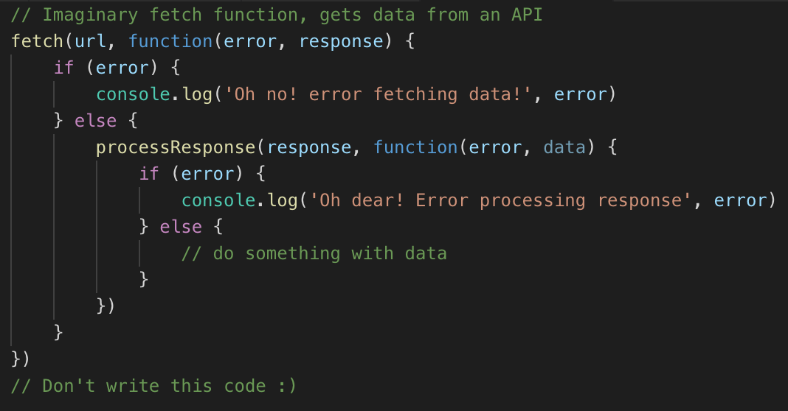
Fetching data from an API
Request data, expect a response
Request may error
Or, a response can be received, which must be processed before use
This might work, data is now available to code
or an error may be encountered (example: expected JSON data, received an image)
With callbacks, you’d need to write something like this
That’s a lot of parenthesis – it’s messy and hard to keep track of what’s happening
Don’t write this code, it won’t work
We'll see another way to write this logic soon

Slide 17
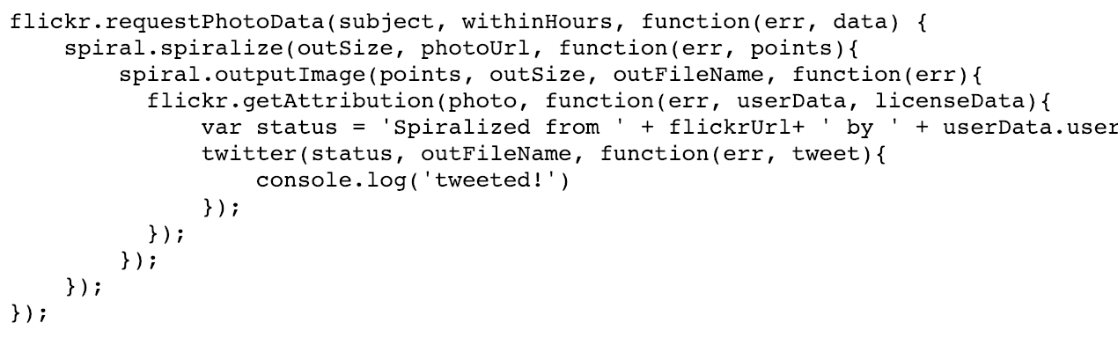
Problems with Callbacks
Callbacks work, but code with many callbacks can get very messy and hard to read
It’s quite common to need to do another task inside a callback function, and that task needs a callback too, and maybe that nested task needs another callback
In JavaScript for a server, you’ll have a callback function for handling a request
Inside that callback, you check if the user is authenticated, which has a callback when the result is ready
Inside that callback, you make a database request, which has a callback for when the data is ready
Inside that callback, you do some processing of the data
Inside that callback, you return the response to the user
yuck. don't write this code!

Slide 18
Lab Project - Capital City Quiz
Website that displays a random country, user guesses the capital city
Page will use a list of countries
You will use the World Bank API to fetch a country’s capital city, by country code

Slide 19
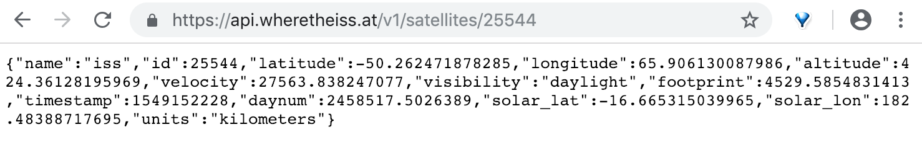
Another API – Where is the International Space Station?
https://wheretheiss.at
Try this API URL: https://api.wheretheiss.at/v1/satellites/25544
backup URL: https://iss-2560.herokuapp.com/iss-now
Will take a few seconds to load the first time you make a request

Slide 20
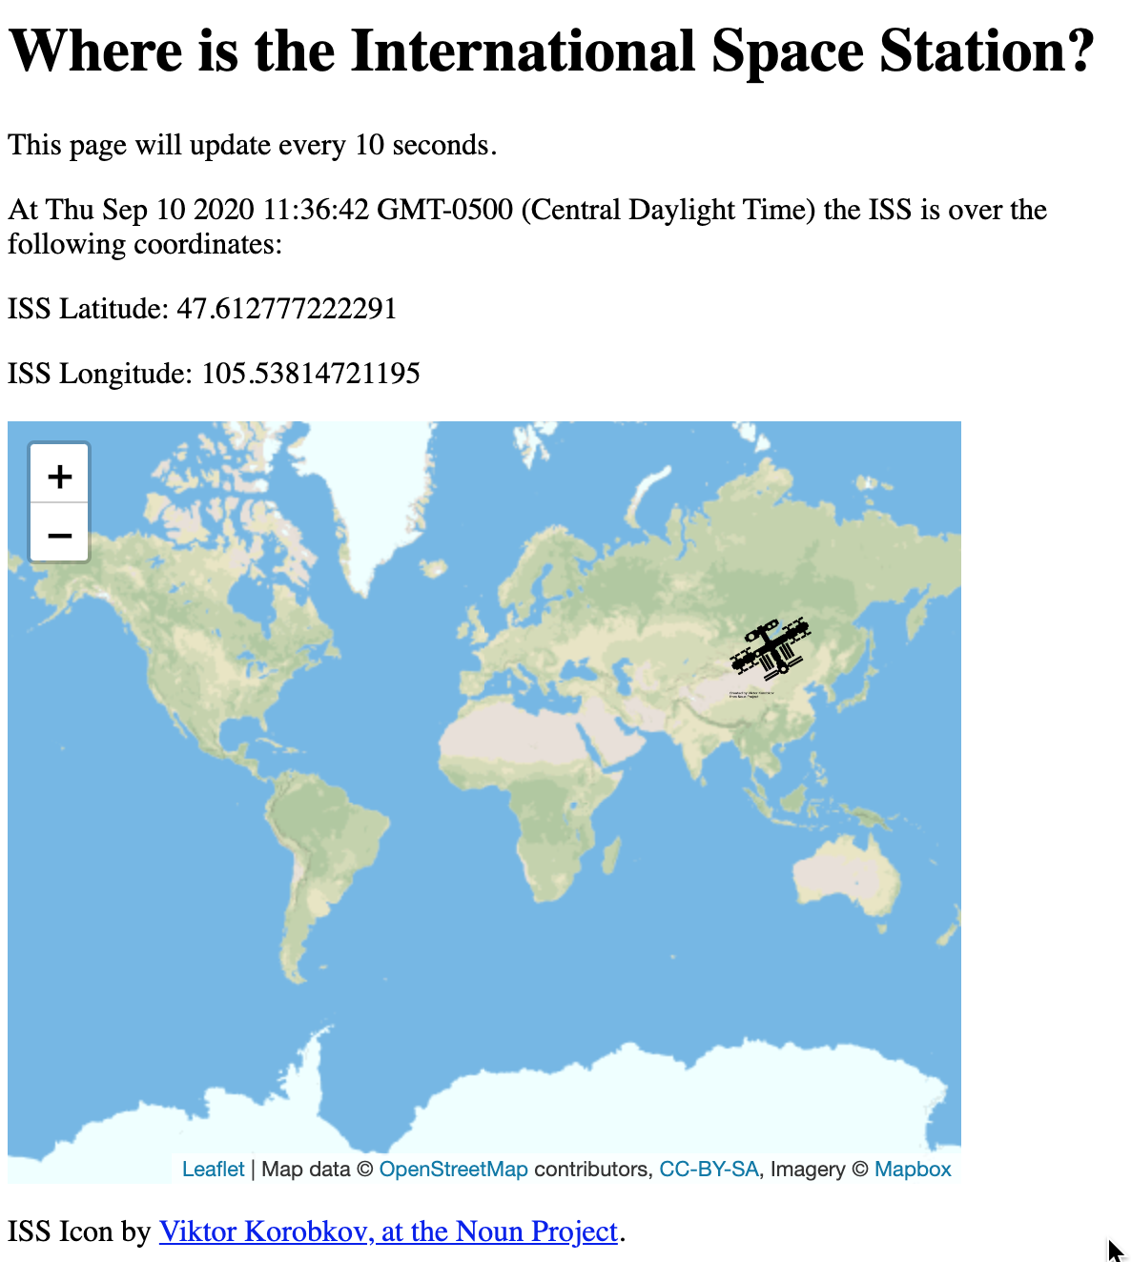
New Project Where is the International Space Station?
Create a website that shows the location of the International Space Station on a Leaflet map
Location and marker updates every 10 seconds

Slide 21
Project setup
Create three new files:
iss_location.html
fetch.js
style.css

Slide 22
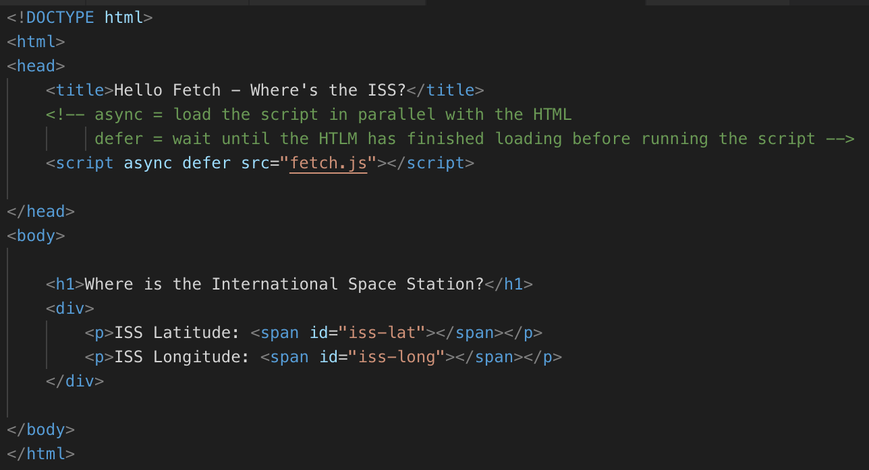
iss_location.html

Slide 23
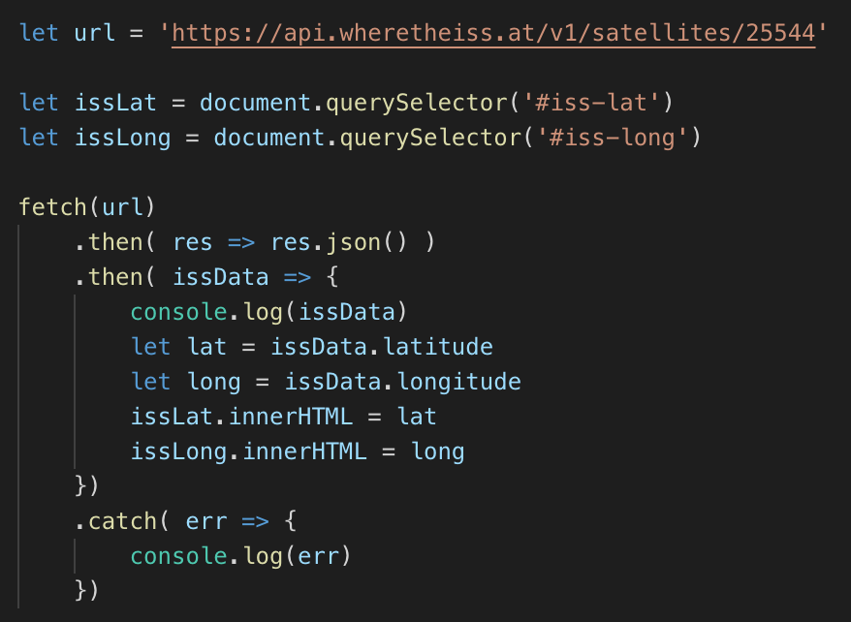
fetch.js
fetch(url) returns a Promise
You could write this with regular callback functions too, but this way is cleaner

Slide 24
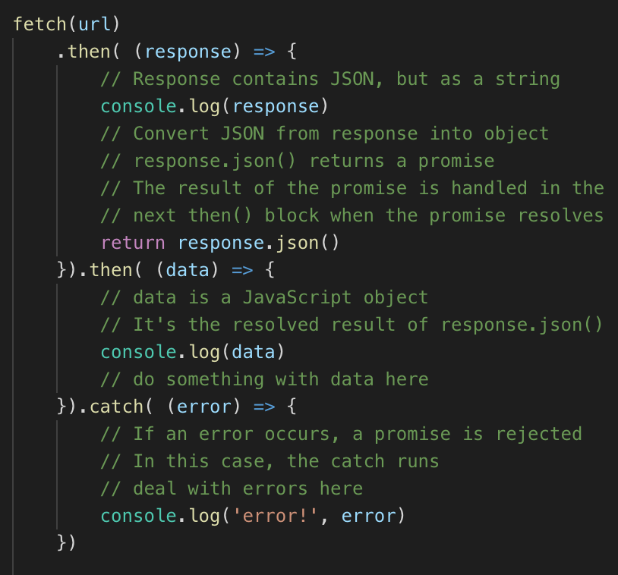
Promise Syntax
fetch returns a promise
A promise can resolve (be successful) or reject (error or fail)
Deal with resolved promises in then()
Deal with rejected promises in catch()

Slide 25
Promise Syntax
Fetching JSON has two steps – the query, and decoding the response from a string to a JavaScript object
First then() receives the entire response from the server. It initiate the decoding with a call to response.json()
response.json() returns another promise
When this promise resolves, it is handled in the second then() block; the result is provided to the data parameter as a JS object
If anything errors, the catch block function is called
data is whatever this promise resolves to

Slide 26
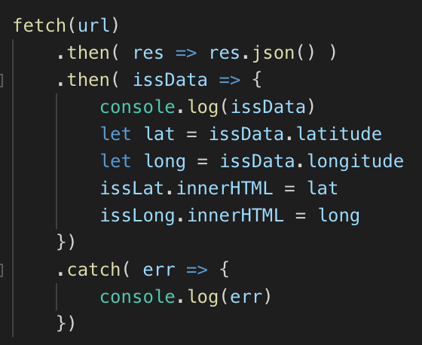
Reminder: Simplify Arrow Functions
In some cases, can simplify arrow function syntax
If exactly one parameter, can omit ( )
If the the {} contains one statement, can omit the {} and just write the statement
If the statement is a return statement, also omit the word return and whatever the statement evaluates to will be returned
Everything will still work if you don't simplify them - it's not required

Slide 27
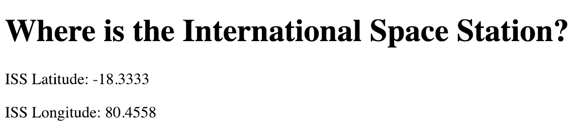
Page should show ISS location
For example,

Slide 28
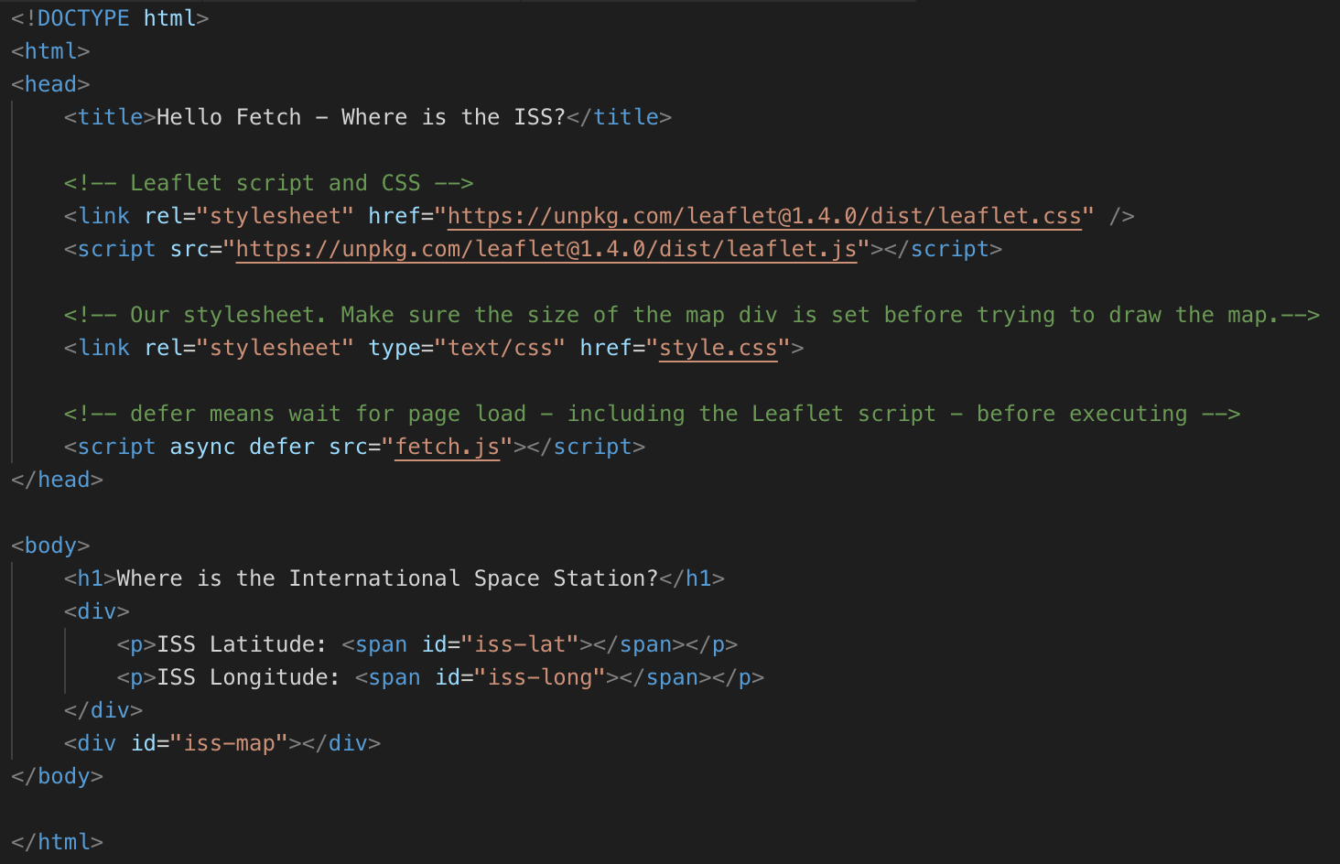
ISS map
Leaflet CSS and JS
Add leaflet CSS and JS
Link in your style.css
Add a div for the map
Stylesheet
Map div
Leaflet JS and CSS - copy from your last project or from https://leafletjs.com/examples/quick-start/

Slide 29
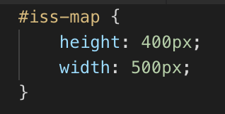
style.css – set height and width of map
Check this is set if your map doesn’t show up - make sure the selector is correct

Slide 30
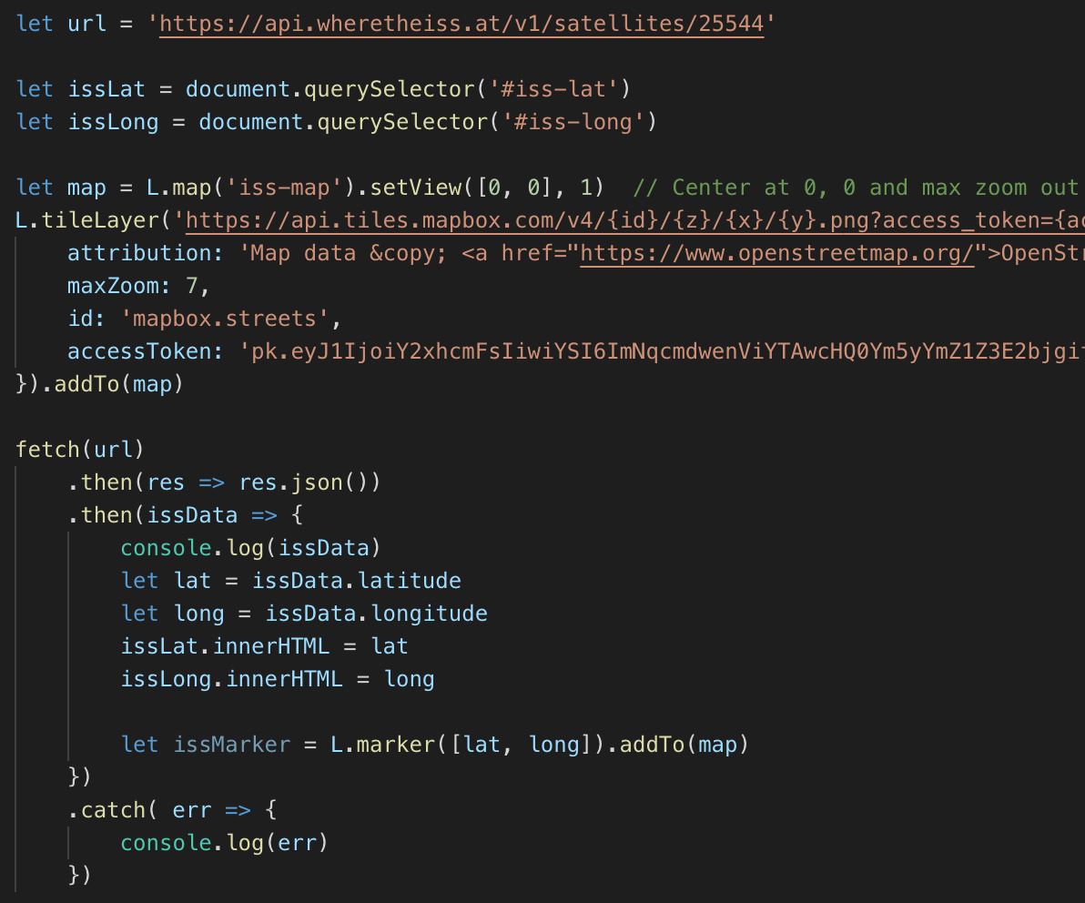
fetch.js – draw map
Use the same tileLayer call, including your access token, that you used last week, in the colleges map
Draw a map of the world, and use the lat-long from the API call to draw a marker

Slide 31
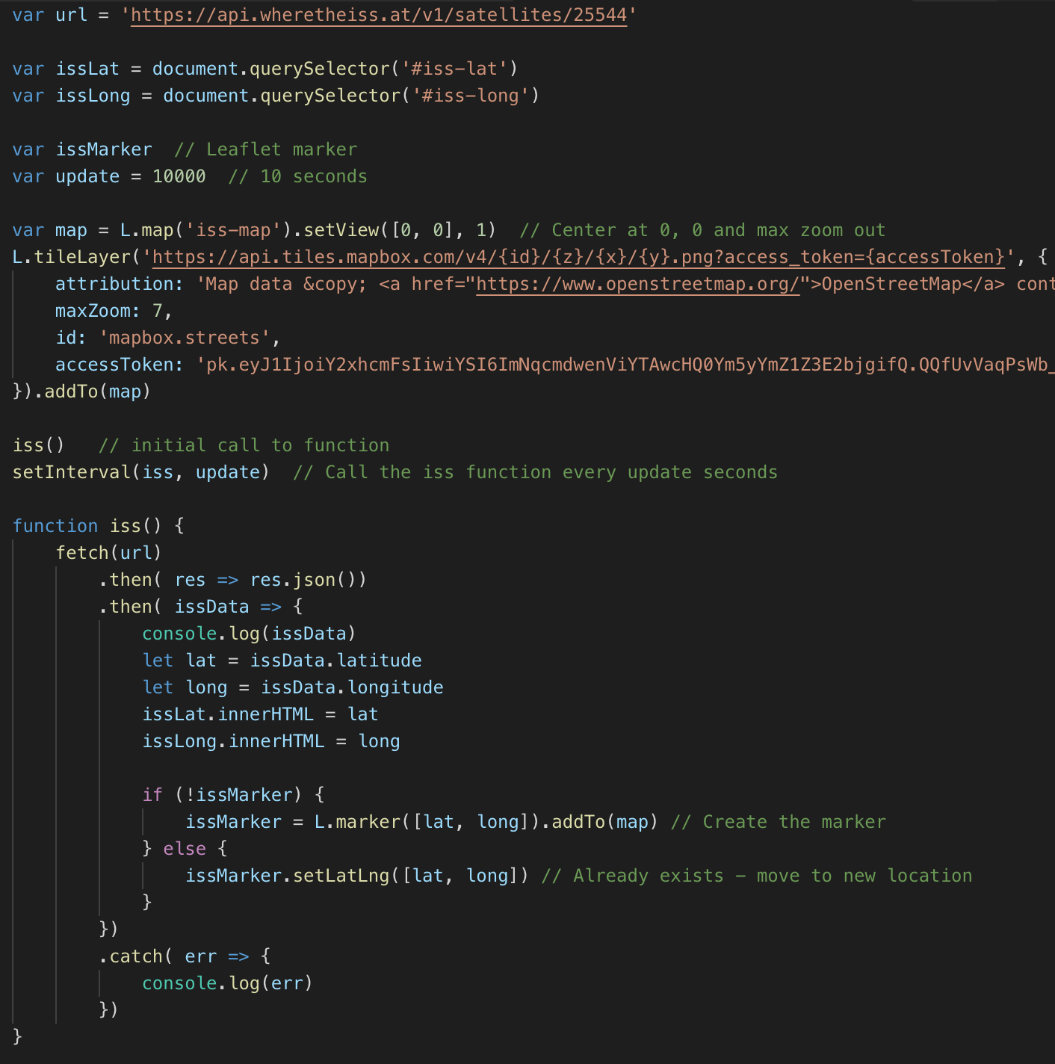
Update the map
Move the fetching code into a function
We can use setInterval to repeat the API call and update the map
Need to make an initial call to iss() since setInterval waits one interval period to start repeatedly calling the function

Slide 32
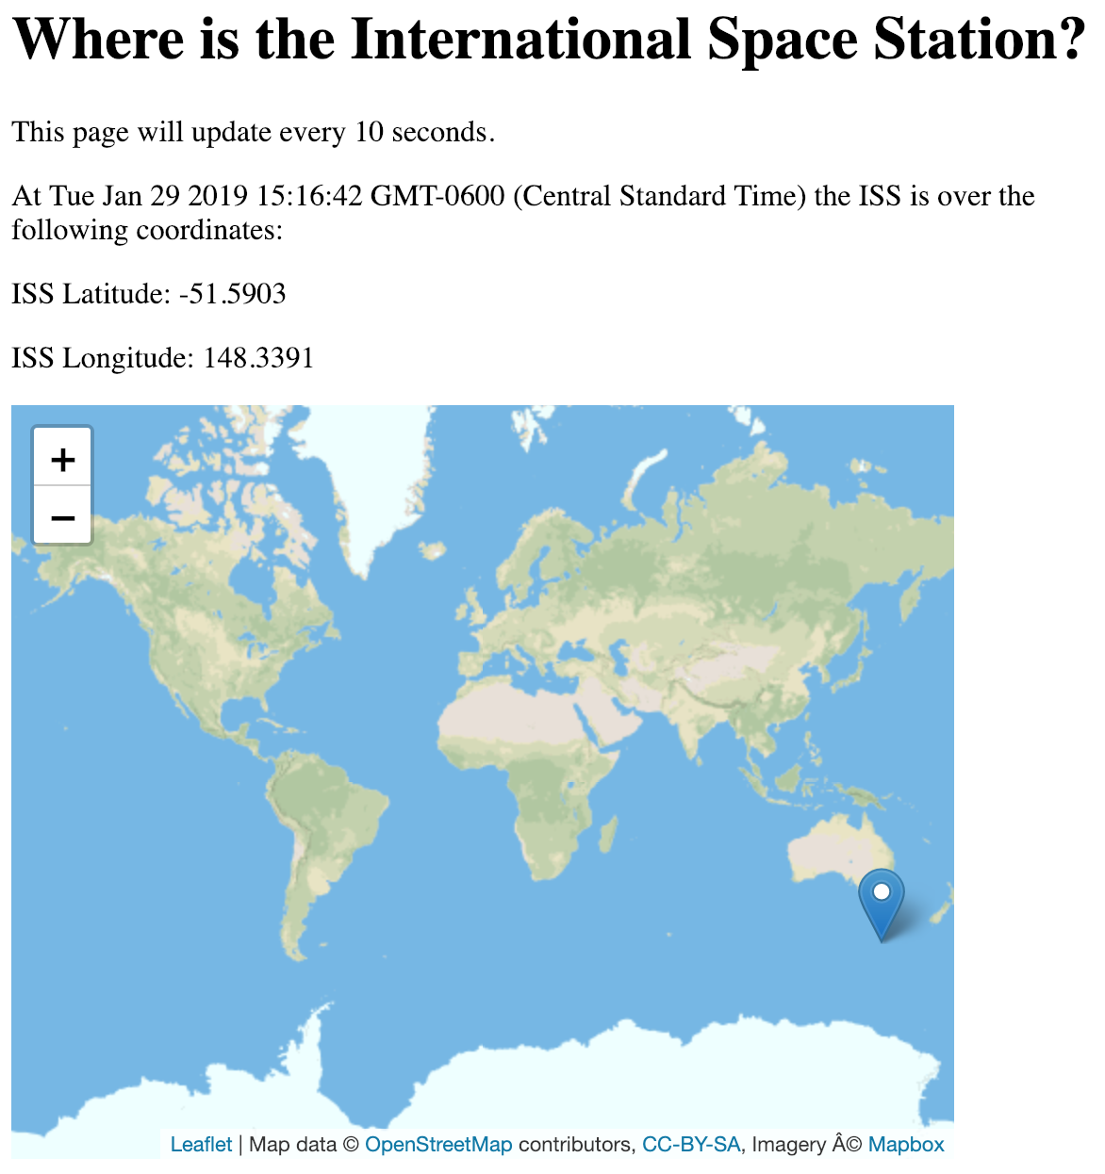
Your turn
Make sure your map works and updates every 10 seconds
Can you add an element to the page that shows the date and time the position was updated?
Update it from inside the iss() function
Can you display an ISS icon, instead of the default marker?

Slide 33

ISS Icon
Use an appropriate icon, for example
ISS icon by Viktor Korobkov, from the Noun Project
https://thenounproject.com/search/?q=iss&creator=2456089&i=956251

Slide 34
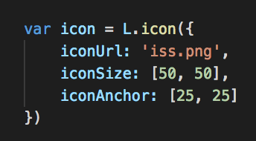
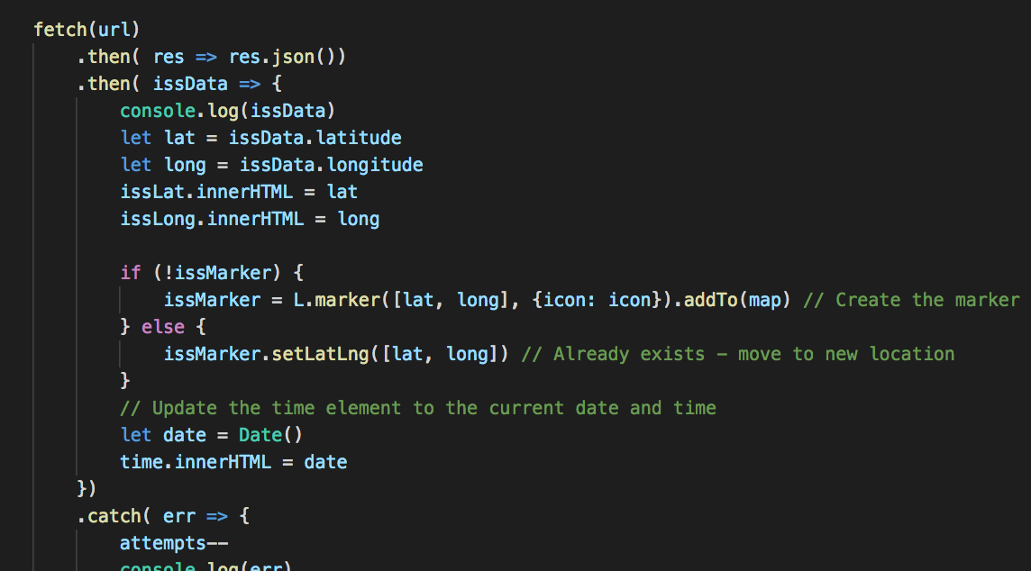
fetch.js using icon for marker
Create an icon
Use the icon when adding the marker for the first time
Modify this line

Slide 35
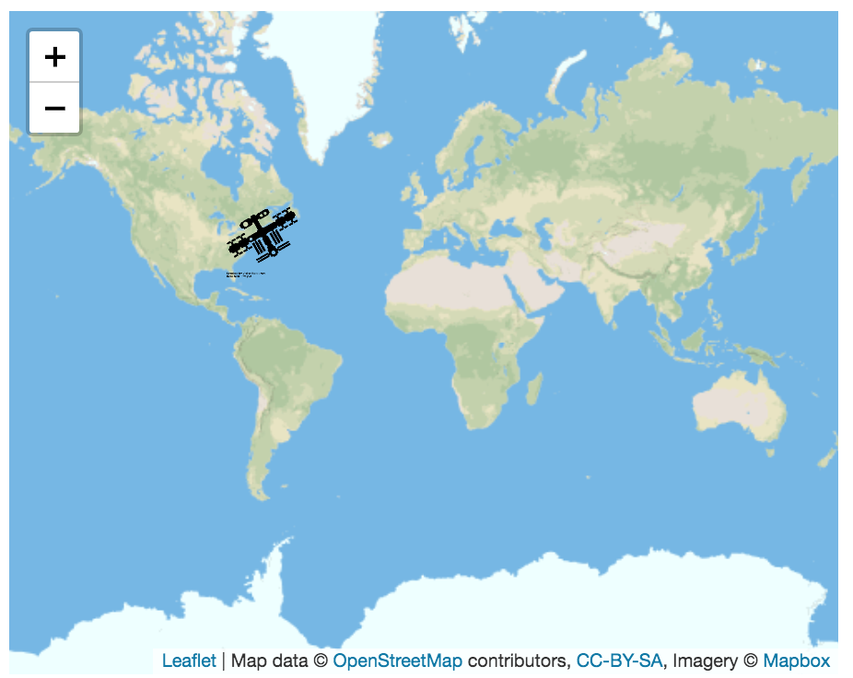
Icon shown for the marker
Test in your browser

Slide 36
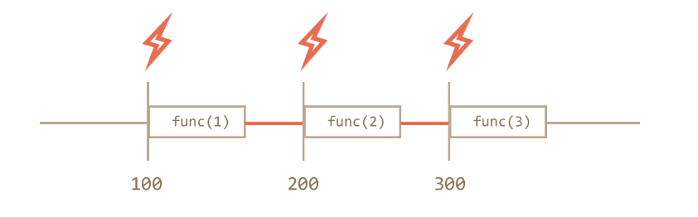
Problem with setInterval
A time diagram with setInterval
What happens if the fetch() takes a long time? Perhaps longer than the interval?
https://javascript.info/settimeout-setinterval

Slide 37
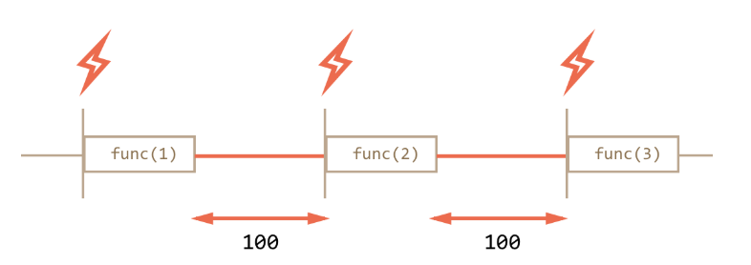
Alternative to setInterval
With setInterval
With recursive setTimeout
https://javascript.info/settimeout-setinterval

Slide 38
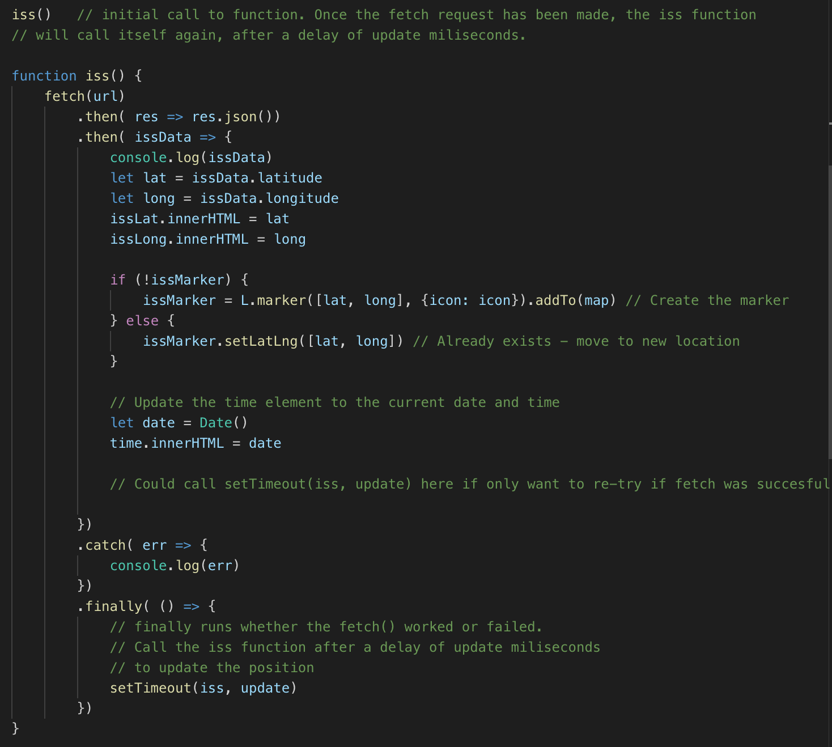
Better approach
Recursive setTimeout
Call the iss function
At the end of the iss function, the iss function will call itself after a timeout
There will now always be update ms between the end of one fetch() and the start of the next, no matter how long it takes to fetch the data

Slide 39
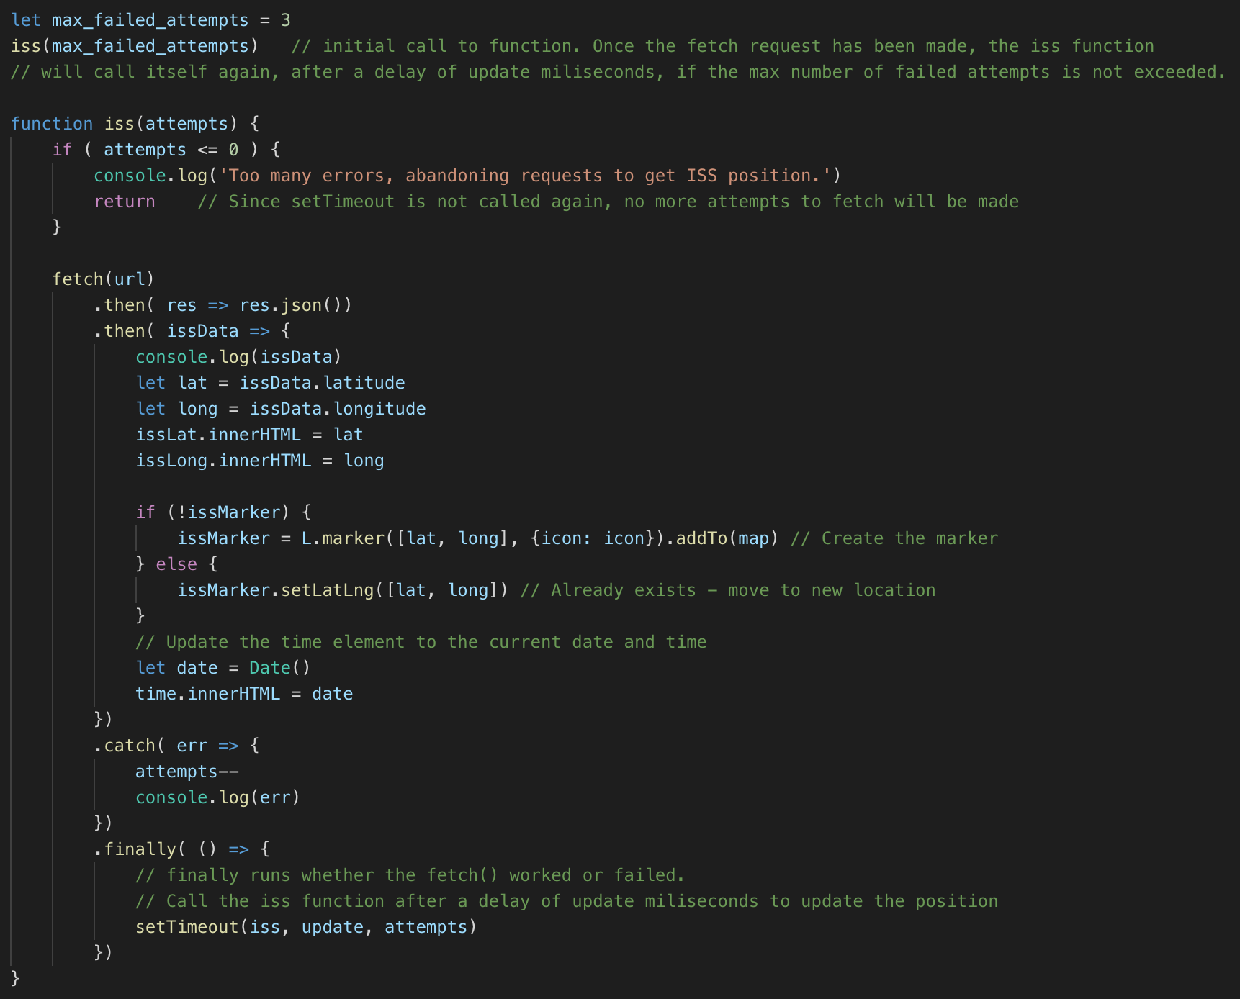
Setting a max number of failed attempts
setTimeout can have optional arguments which are passed to the callback function

Slide 40
Create a git repository for your work
Push your work to GitHub
Enable GitHub pages - instructions in D2L
Make sure all your pages - current time, ISS location map - are live
You will need to turn project 1 in using GitHub
If you need any help using git and GitHub, PLEASE ASK!
I am happy to help you get set up or troubleshoot, so please ask!

Slide 41
Other APIs to use
List here https://github.com/public-apis/public-apis
Tips for working with APIs on pages
Use the free APIs which don't need authentication or keys, since you won't be able to keep those secret
Only APIs that use HTTPS work on GitHub pages

Slide 42
Lab
World Bank API - Capital City Quiz Page

